Slide 1
Arithmetic for Computers

Slide 2
Topics
Arithmetic
Signed and unsigned numbers
Addition and Subtraction
Logical operations
ALU: arithmetic and logic unit
Multiply
Divide
Floating Point
  notation
  add
  multiply
TU/e Processor Design 5Z032

Slide 3
Arithmetic
Where we've been:
  Performance (seconds, cycles, instructions)
  Abstractions:
  Instruction Set Architecture
  Assembly Language and Machine Language
What's up ahead:
  Implementing the Architecture
operation
a
32
ALU
result
32
b
32
TU/e Processor Design 5Z032

Slide 4
Binary numbers (1)
Bits have no inherent meaning (no semantics)
Decimal number system, e.g.:
4382 = 4x10³ + 3x10² + 8x10¹ + 2x10⁰
Can use arbitrary base g; value of digit c at position i:
c x g^{i}
Binary numbers (base 2)
  n-1 n-2 … 1 0
  a_{n-1} a_{n-2} … a₁ a₀
  2^{n-1} 2^{n-2} … 2¹ 2⁰
(a_{n-1} a_{n-2}... a₁ a₀) _{two} = a_{n-1} x 2^{n-1} + a_{n-2} x 2^{n-2} + … + a₀ x 2⁰
position
digit
weight
TU/e Processor Design 5Z032

Slide 5
Binary numbers (2)
So far numbers are unsigned
With n bits 2^{n} possible combinations
  a₀ : least significant bit (lsb)
  a_{n-1}: most significant bit (msb)
1 bit 2 bits 3 bits 4 bits decimal value
0 00 000 0000 0
1 01 001 0001 1
10 010 0010 2
11 011 0011 3
100 0100 4
101 0101 5
110 0110 6
111 0111 7
1000 8
1001 9
TU/e Processor Design 5Z032

Slide 6
Binary numbers (3)
Binary numbers (base 2)
0000 0001 0010 0011 0100 0101 0110 0111 1000 1001...
decimal: 0...2^{n}-1
Of course it gets more complicated:
- numbers are finite (overflow)
- fractions and real numbers
- negative numbers
  e.g., no MIPS subi instruction;
  however, addi can add a negative number
How do we represent negative numbers?
i.e., which bit patterns will represent which numbers?
TU/e Processor Design 5Z032

Slide 7
Conversion
Decimal -> binary
      Divide by 2 Remainder
Hexadecimal: base 16. Octal: base 8
      1010 1011 0011 1111_{two} = ab3f_{hex}
4382
2191 0
1095 1
547 1
273 1
136 1
68 0
34 0
17 0
8 1
4 0
2 0
1 0
0 1
4382_{ten} =
1 0001 0001 1110_{two}
TU/e Processor Design 5Z032

Slide 8
Signed binary numbers
Possible representations:
Sign Magnitude: One's Complement Two's Complement
000 = +0 000 = +0 000 = +0
001 = +1 001 = +1 001 = +1
010 = +2 010 = +2 010 = +2
011 = +3 011 = +3 011 = +3
100 = -0 100 = -3 100 = -4
101 = -1 101 = -2 101 = -3
110 = -2 110 = -1 110 = -2
111 = -3 111 = -0 111 = -1
Issues: balance, number of zeros, ease of operations
Which one is best? Why?
TU/e Processor Design 5Z032

Slide 9
Two’s complement
(let’s restrict to 4 bits)
0000
1111
0001
-1
0
1
0010
1110
15
-2
2
14
1101
-3
0011
13
3
-4
12
positive
1100
4
0100
negative
11
-5
5
1011
0101
10
-6
9
6
1010
8
0110
-7
7
-8
1001
0111
1000
TU/e Processor Design 5Z032

Slide 10
Two’s complement
3+2=5
0000
1111
0001
-1
0
1
0010
1110
15
-2
2
14
1101
-3
0011
13
3
-4
12
positive
1100
4
0100
negative
11
-5
5
1011
0101
10
-6
9
6
1010
8
0110
-7
7
-8
1001
0111
1000
TU/e Processor Design 5Z032

Slide 11
Two’s complement
3+ (-5) = -2
0000
1111
0001
-1
0
1
0010
1110
15
-2
2
14
1101
-3
0011
13
3
-4
12
positive
1100
4
0100
negative
11
-5
5
1011
0101
10
-6
9
6
1010
8
0110
-7
7
-8
1001
0111
1000
TU/e Processor Design 5Z032

Slide 12
Two’s complement
3+6 = -7 !!
overflow
0000
1111
0001
-1
0
1
0010
1110
15
-2
2
14
1101
-3
0011
13
3
-4
12
positive
1100
4
0100
negative
11
-5
5
1011
0101
10
-6
9
6
1010
8
0110
-7
7
-8
1001
0111
1000
TU/e Processor Design 5Z032

Slide 13
Two’s complement
-3 + (-6) = 7 !!
underflow
0000
1111
0001
-1
0
1
0010
1110
15
-2
2
14
1101
-3
0011
13
3
-4
12
positive
1100
4
0100
negative
11
-5
5
1011
0101
10
-6
9
6
1010
8
0110
-7
7
-8
1001
0111
1000
TU/e Processor Design 5Z032

Slide 14
Two's Complement Operations
Negating a two's complement number: invert all bits and add 1
  remember: “negate” and “invert” are quite different!
Proof:
a + a = 1111.1111b = -1 d =>
-a = a + 1
TU/e Processor Design 5Z032

Slide 15
Two's Complement Operations
Converting n bit numbers into numbers with more than n bits:
  MIPS 8 bit, 16 bit values / immediates converted to 32 bits
Copy the most significant bit (the sign bit) into the other bits
0010 -> 0000 0010
1010 -> 1111 1010
MIPS "sign extension" example instructions:
    lb load byte (signed)
    lbu load byte (unsigned)
    slti set less than immediate (signed)
    sltiu set less than immediate (unsigned)
TU/e Processor Design 5Z032

Slide 16
Addition & Subtraction
Just like in grade school (carry/borrow 1s)
0111 0111 0110
+ 0110 - 0110 - 0101
Two's complement operations easy
  subtraction using addition of negative numbers
  0110 0110
  - 0101 + 1010
Overflow (result too large for finite computer word):
  e.g., adding two n-bit numbers does not yield an n-bit number
  0111
  + 0001 note that overflow term is somewhat misleading,
  1000 it does not mean a carry “overflowed”
TU/e Processor Design 5Z032

Slide 17
Detecting Overflow
No overflow when adding a positive and a negative number
No overflow when signs are the same for subtraction
Overflow occurs when the value affects the sign:
  overflow when adding two positives yields a negative
  or, adding two negatives gives a positive
  or, subtract a negative from a positive and get a negative
  or, subtract a positive from a negative and get a positive
Consider the operations A + B, and A – B
  Can overflow occur if B is 0 ?
  Can overflow occur if A is 0 ?
TU/e Processor Design 5Z032

Slide 18
Effects of Overflow
When an exception (interrupt) occurs:
  Control jumps to predefined address for exception
  (interrupt vector)
  Interrupted address is saved for possible resumption in exception program counter (EPC); new instruction: mfc0
  (move from coprocessor0)
  Interrupt handler handles exception (part of OS).
  registers $k0 and $k1 reserved for OS
Details based on software system / language
  C ignores integer overflow; FORTRAN not
Don't always want to detect overflow
— new MIPS instructions: addu, addiu, subu
note: addiu and sltiu still sign-extends!
TU/e Processor Design 5Z032

Slide 19
Logic operations
Sometimes operations on individual bits needed:
    Logic operation C operation MIPS instruction
    Shift left logical << sll
    Shift right logical >> srl
    Bit-by-bit AND & and, andi
    Bit-by-bit OR | or, ori
and and andi can be used to turn off some bits;
or and ori turn on certain bits
Of course, AND en OR can be used for logic operations.
  Note: Language C’s logical AND (&&) and OR (||) are conditional
andi and ori perform no sign extension !
TU/e Processor Design 5Z032

Slide 20
Exercise: gates
Given: 3-input logic function of A, B and C, 2-outputs
Output D is true if at least 2 inputs are true
Output E is true if odd number of inputs true
Give truth-table
Give logic equations
Give implementation with AND and OR gates, and Inverters.
TU/e Processor Design 5Z032

Slide 21
An ALU (arithmetic logic unit)
Let's build an ALU to support the andi and ori instructions
  we'll just build a 1 bit ALU, and use 32 of them
operation
a
result
b
TU/e Processor Design 5Z032

Slide 22
Review: The Multiplexer
Selects one of the inputs to be the output, based on a control input
Lets build our ALU and use a MUX to select the
outcome for the chosen operation
S
note: we call this a 2-input mux
even though it has 3 inputs!
A
0
C
B
1
TU/e Processor Design 5Z032

Slide 23
Different Implementations
Not easy to decide the “best” way to build something
  Don't want too many inputs to a single gate
  Don’t want to have to go through too many gates
  For our purposes, ease of comprehension is important
Let's look at a 1-bit ALU for addition (= full-adder):
CarryIn
c_{out} = a b + a c_{in} + b c_{in}
sum = a xor b xor c_{in}
a
+
Sum
b
CarryOut
How could we build a 1-bit ALU for add, and, and or?
How could we build a 32-bit ALU?
TU/e Processor Design 5Z032

Slide 24
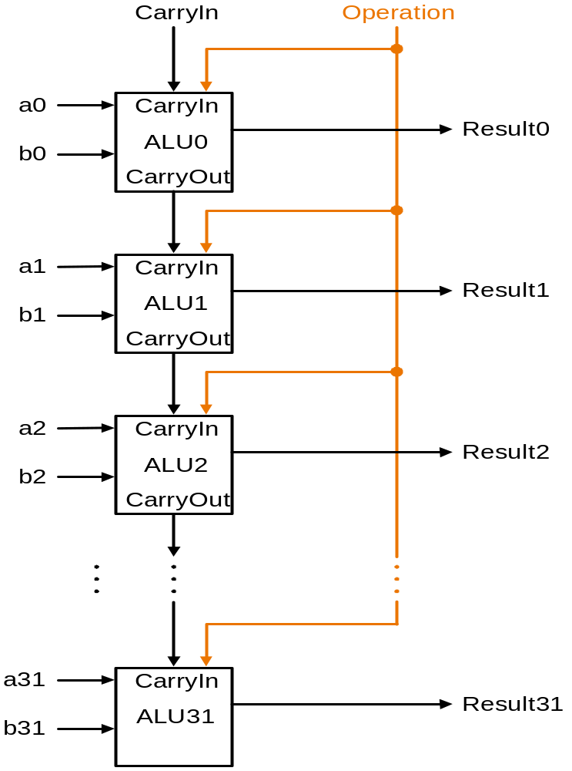
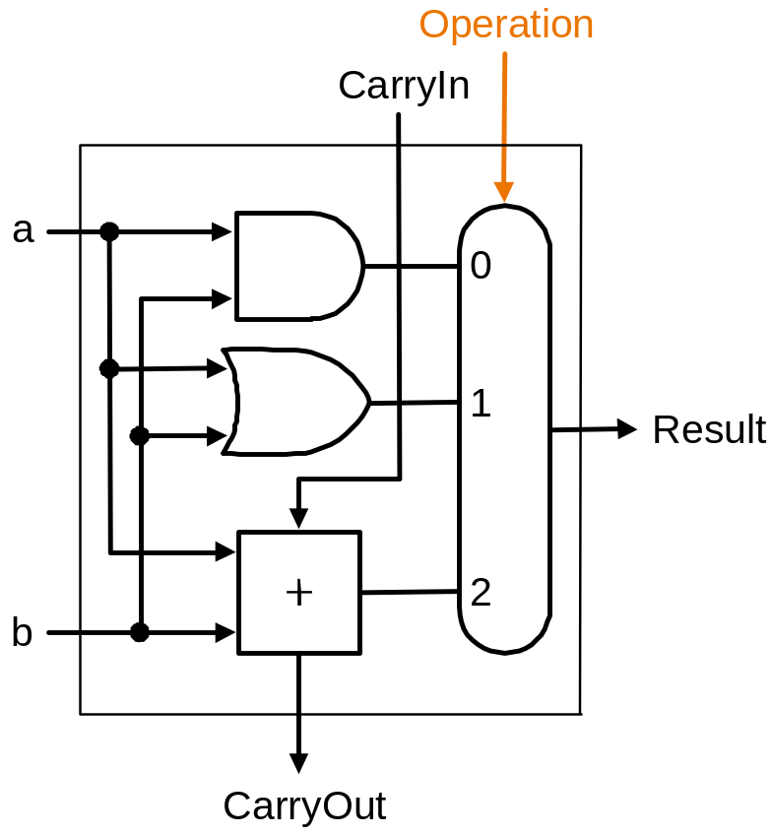
Building a 32 bit ALU
TU/e Processor Design 5Z032

Slide 25
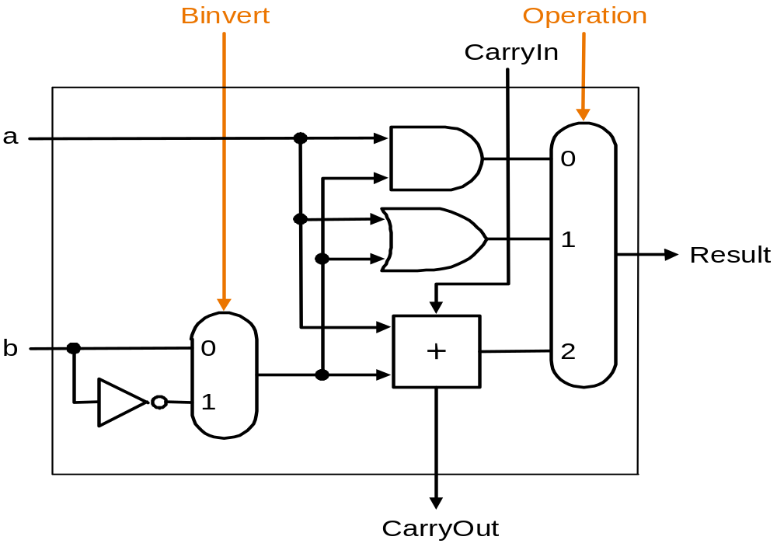
What about subtraction (a – b) ?
Two's complement approach: just negate b and add
How do we negate?
A very clever solution:
TU/e Processor Design 5Z032

Slide 26
ALU symbol
operation
32
a
zero
ALU
32
result
overflow
32
b
carry-out
TU/e Processor Design 5Z032

Slide 27
Conclusions
We can build an ALU to support the MIPS instruction set
  key idea: use multiplexor to select the output we want
  we can efficiently perform subtraction using two’s complement
  we can replicate a 1-bit ALU to produce a 32-bit ALU
Important points about hardware
  all of the gates are always working
    not efficient from energy perspective !!
  the speed of a gate is affected by the number of connected outputs it has to drive (so-called Fan-Out)
  the speed of a circuit is affected by the number of gates in series
  (on the “critical path” or the “deepest level of logic”)
    Unit of measure: FO4 = inverter with Fan-Out of 4
    P4 (heavily superpipelined) has about 15 FO4 critical path
TU/e Processor Design 5Z032

Slide 28
Multiplication (1)
More complicated than addition
  accomplished via shifting and addition
More time and more area
Let's look at 3 versions based on gradeschool algorithm
0010 (multiplicand)
__*_1011 (multiplier)
Negative numbers: convert and multiply
  there are better techniques, we won’t look at them now
TU/e Processor Design 5Z032

Slide 29
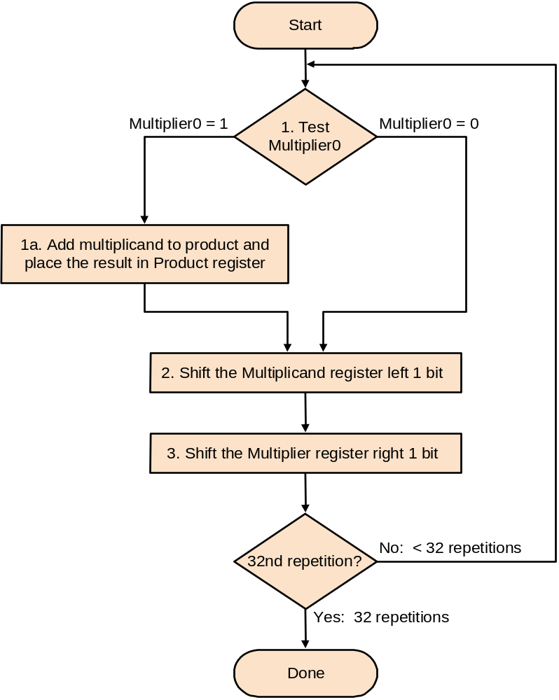
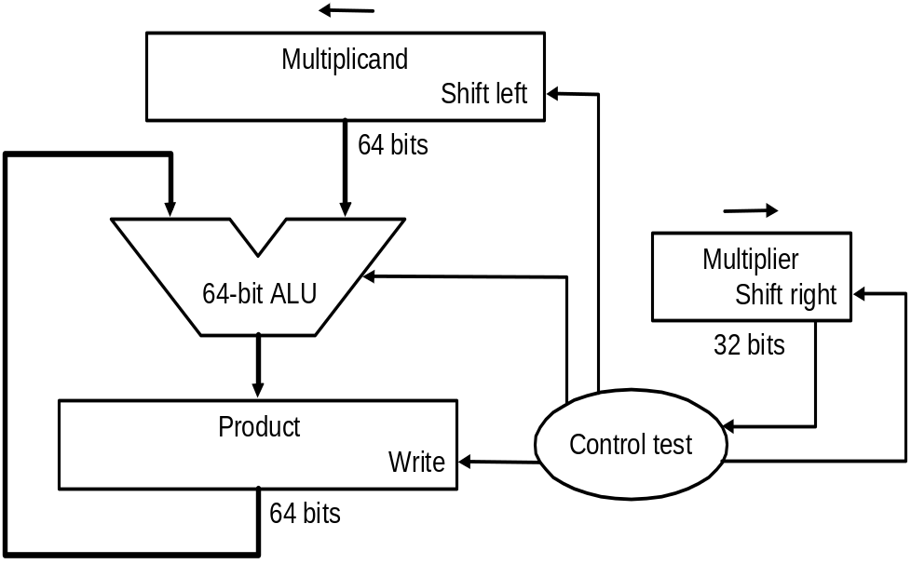
Multiplication (2)
First implementation
Product initialized to 0
TU/e Processor Design 5Z032

Slide 30
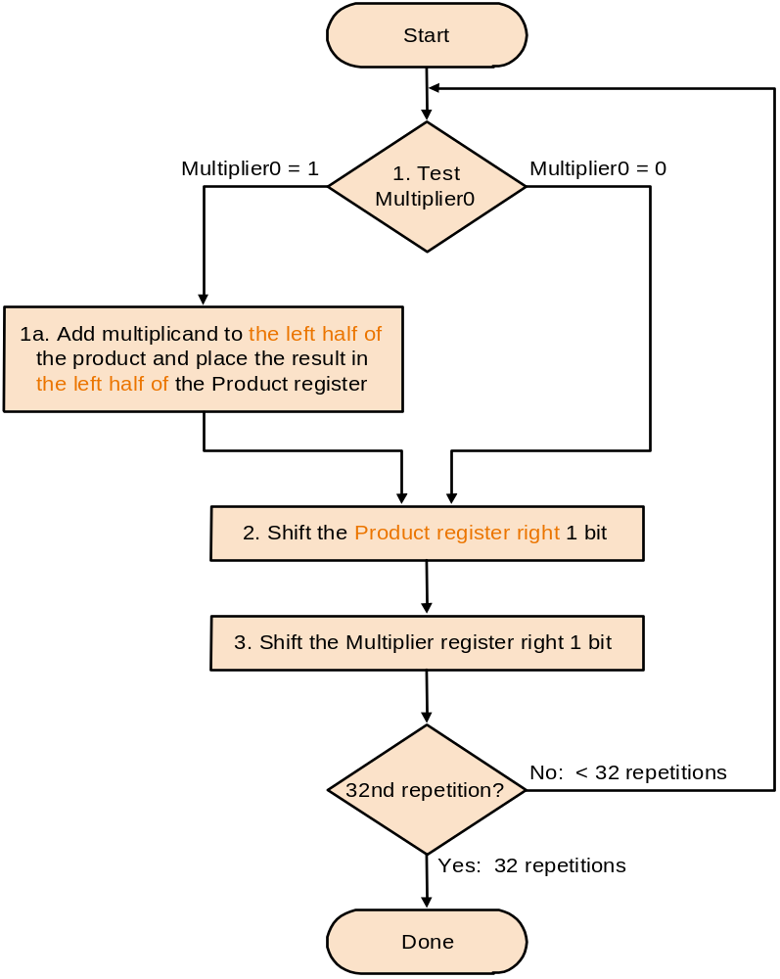
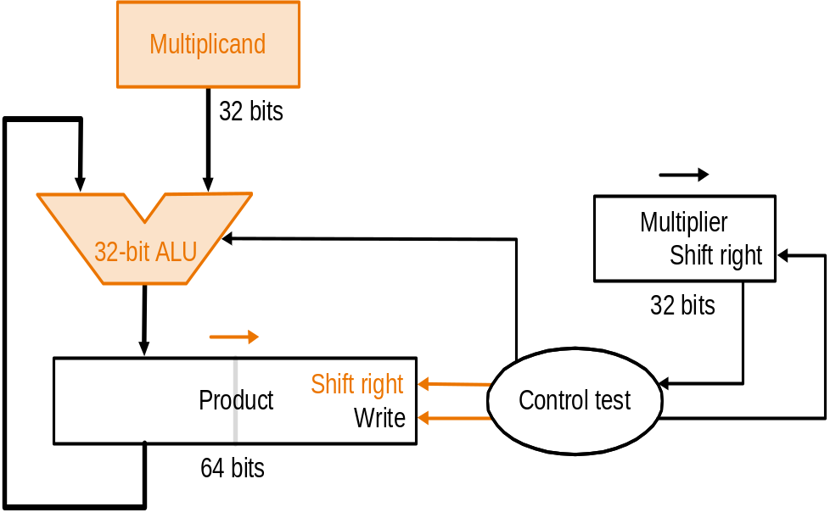
Multiplication (3)
Second version
TU/e Processor Design 5Z032

Slide 31
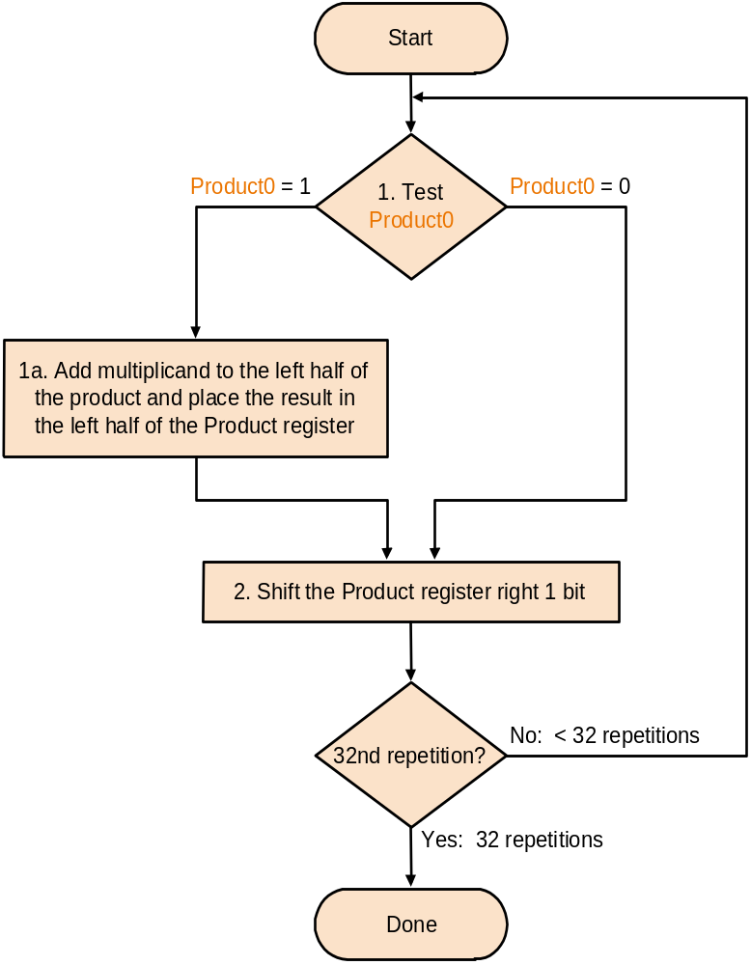
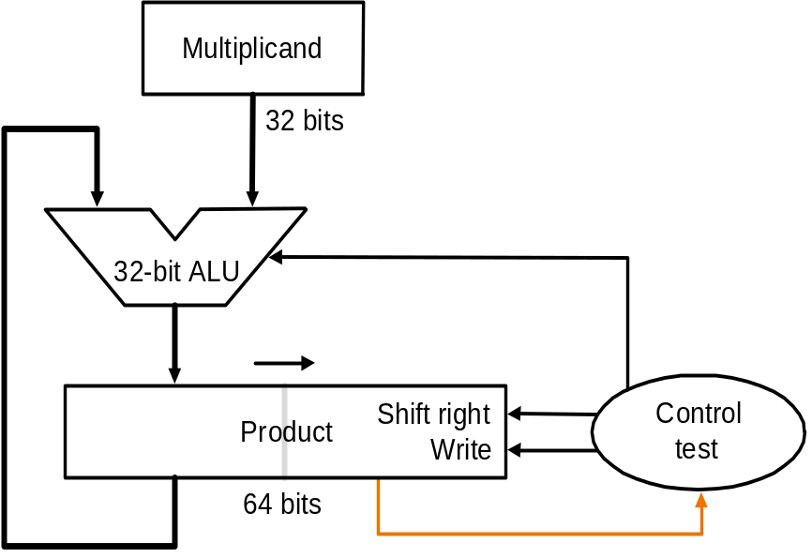
Multiplication (4)
Final version
Product initialized with multiplier
TU/e Processor Design 5Z032

Slide 32
Sequential Circuit Multiplier The combinational array multiplier just described uses a large number of logic gates for multiplying numbers of practical size, such as 32- or 64-bit numbers. Multiplication of two n-bit numbers can also be performed in a sequential circuit that uses a single n-bit adder. The block diagram in Figure a shows the hardware arrangement for sequential multiplication. This circuit performs multiplication by using a single n-bit adder n times to implement the spatial addition performed by the n rows of ripple-carry adders in Figure
TU/e Processor Design 5Z032

Slide 33
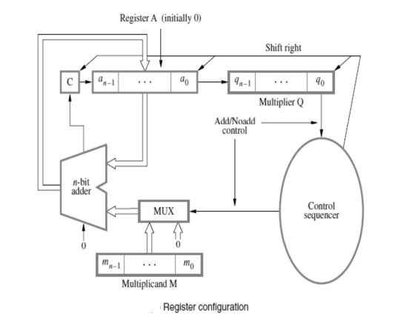
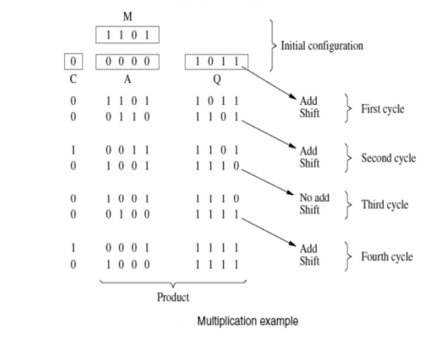
Sequential multiplier
TU/e Processor Design 5Z032

Slide 34
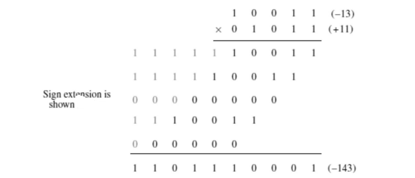
Multiplication of Signed Numbers
TU/e Processor Design 5Z032

Slide 35
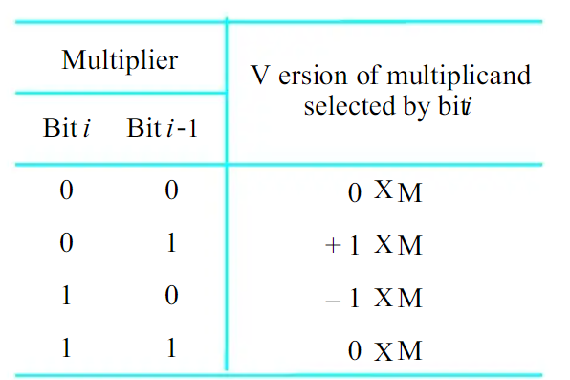
Booth’s algorithm
Booth’s algorithm is a powerful algorithm that is used for signed multiplication. It generates a 2n bit product
for two n bit signed numbers.

Slide 36
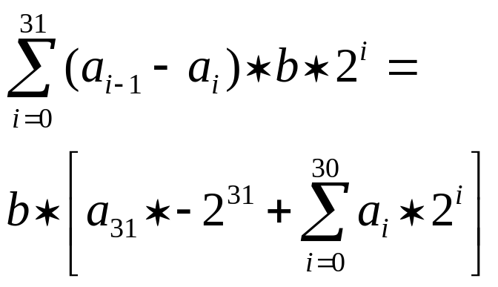
Booth’s Algorithm (2)
Booth’s algorithm works for signed 2’s complement as well (without any modification)
Proof: let’s multiply b * a
(a_{i-1} - a_{i} ) indicates what to do:
0 : do nothing
+1: add b
-1 : subtract
We get b*a =
This is exactly what we need !

Slide 37
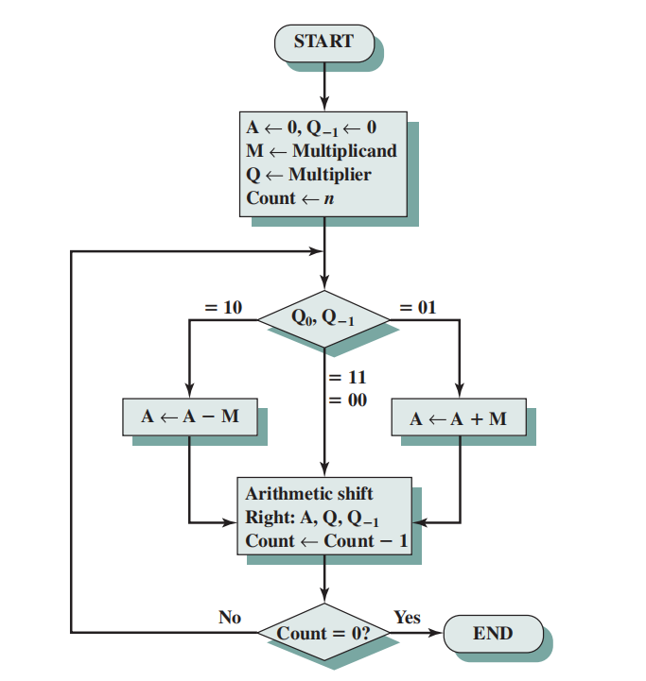
Booth’s algorithm

Slide 38
Booth’s algorithm
Set the Multiplicand and Multiplier binary bits as M and Q, respectively.
Initially, we set the AC and Q_{n + 1} registers value to 0.
SC represents the number of Multiplier bits (Q), and it is a sequence counter that is continuously decremented till equal to the number of bits (n) or reached to 0.
A Qn represents the last bit of the Q, and the Q_{n+1} shows the incremented bit of Qn by 1.
On each cycle of the booth algorithm, Q_{n} and Q_{n + 1} bits will be checked on the following parameters as follows:
  When two bits Q_{n} and Q_{n + 1} are 00 or 11, we simply perform the arithmetic shift right operation (ashr) to the partial product AC. And the bits of Qn and Q_{n + 1} is incremented by 1 bit.
  If the bits of Q_{n} and Q_{n + 1} is shows to 01, the multiplicand bits (M) will be added to the AC (Accumulator register). After that, we perform the right shift operation to the AC and QR bits by 1.
  If the bits of Q_{n} and Q_{n + 1} is shows to 10, the multiplicand bits (M) will be subtracted from the AC (Accumulator register). After that, we perform the right shift operation to the AC and QR bits by 1.
The operation continuously works till we reached n - 1 bit in the booth algorithm.
Results of the Multiplication binary bits will be stored in the AC and QR registers.

Slide 39
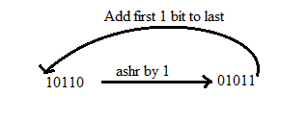
Shift operation
1. RSC (Right Shift Circular)
It shifts the right-most bit of the binary number, and then it is added to the beginning of the binary bits.
2. RSA (Right Shift Arithmetic)
It adds the two binary bits and then shift the result to the right by 1-bit position.
Example: 0100 + 0110 => 1010, after adding the binary number shift each bit by 1 to the right and put the first bit of resultant to the beginning of the new bit.

Slide 40
Exercise
Multiply the two numbers 7 and 3 by using the Booth's multiplication algorithm.
Ans. Here we have two numbers, 7 and 3. First of all, we need to convert 7 and 3 into binary numbers like 7 = (0111) and 3 = (0011). Now set 7 (in binary 0111) as multiplicand (M) and 3 (in binary 0011) as a multiplier (Q).
And SC (Sequence Count) represents the number of bits, and here we have 4 bits, so set the SC = 4.
Also, it shows the number of iteration cycles of the booth's algorithms and then cycles run SC = SC - 1 time.
TU/e Processor Design 5Z032

Slide 41
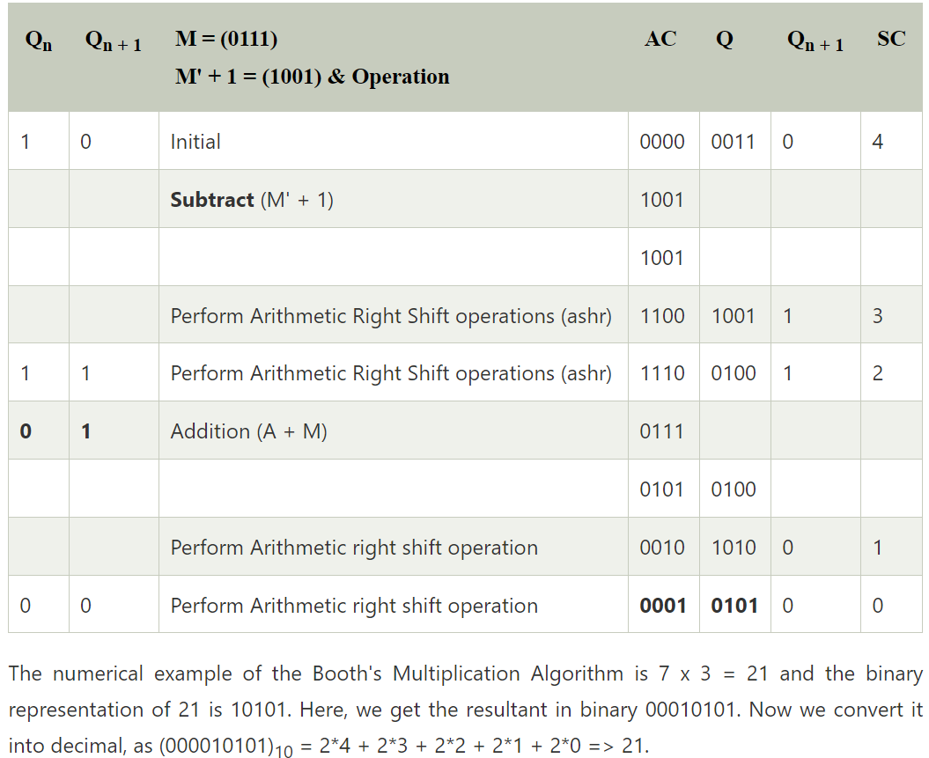

Example –Booth’s algorithm
TU/e Processor Design 5Z032

Slide 42
Exercise
Multiply the two numbers 23 and -9 by using the Booth's multiplication algorithm.
Here, M = 23 = (010111) and Q = -9 = (110111)
Solution: next slide
TU/e Processor Design 5Z032

Slide 43
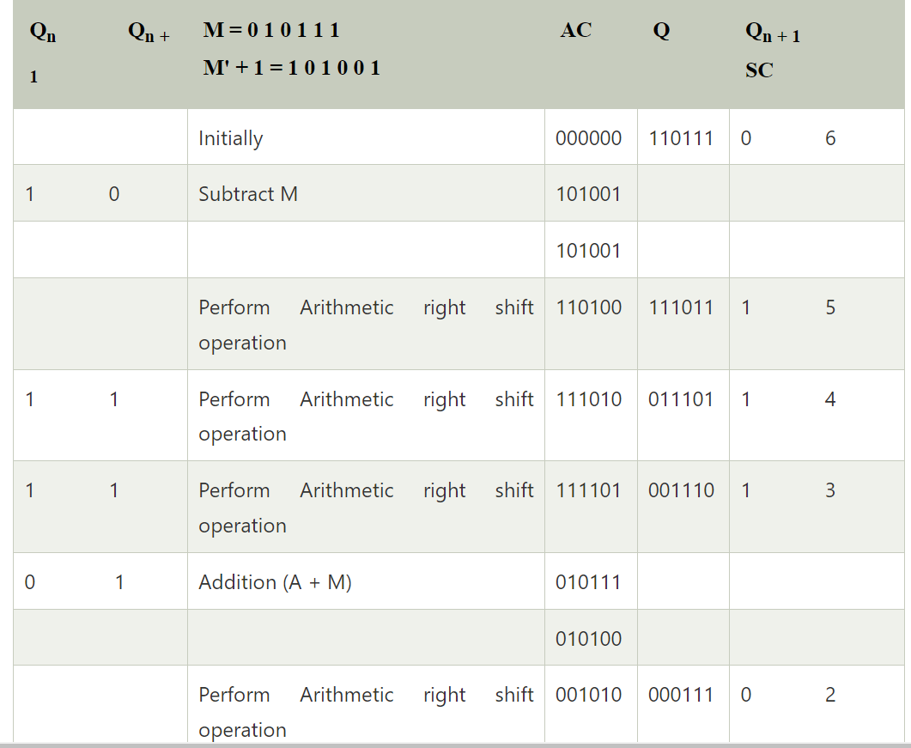
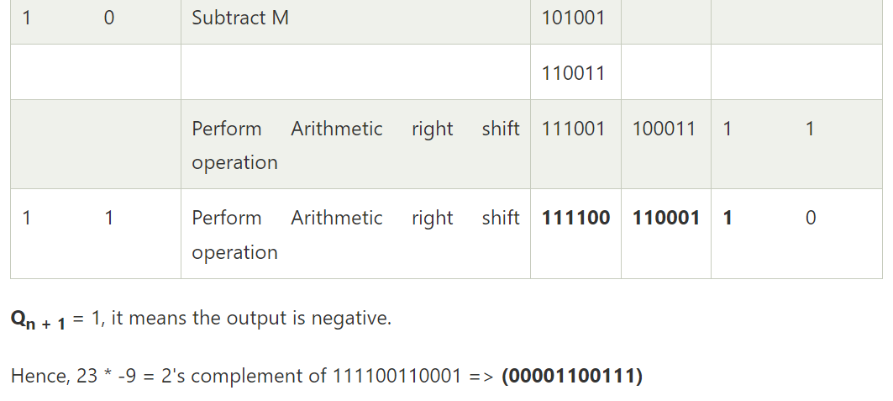
TU/e Processor Design 5Z032

Slide 44
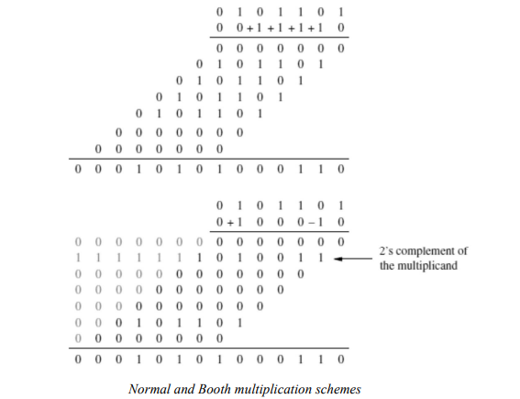
The Booth algorithm can also be used directly for negative multipliers
TU/e Processor Design 5Z032

Slide 45
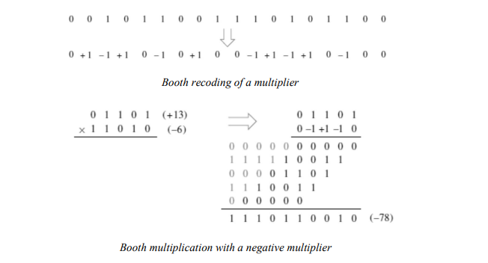
Booth multiplication with a negative multiplier
TU/e Processor Design 5Z032

Slide 46
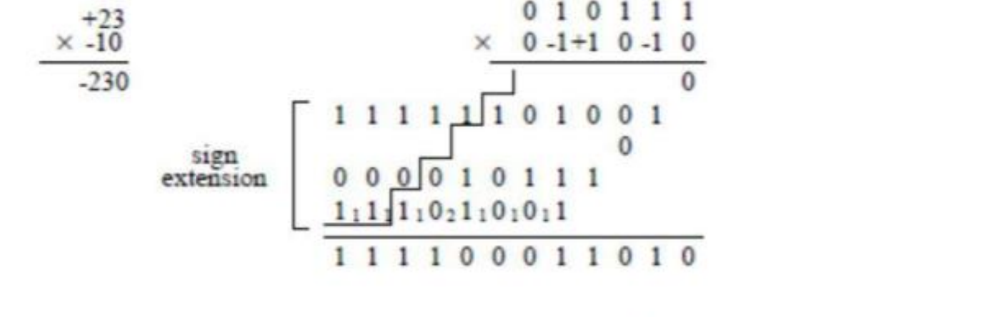
Exercise
Problem 4: Perform signed multiplication of following 2’s complement numbers using Booth’s algorithm.
(a) A=010111 and B=110110
(b) A=110011 and B=101100 (c) A=110101 and B=011011 (d) A=001111 and B=001111 (e) A=10100 and B=10101 (f) A=01110 and B=11000
TU/e Processor Design 5Z032

Slide 47
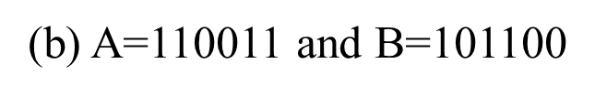
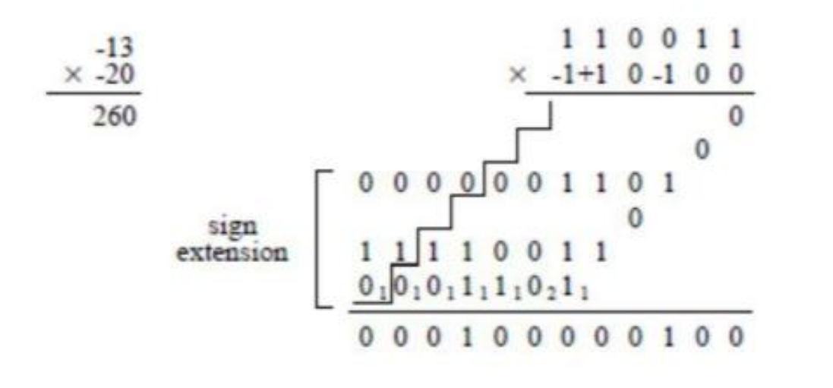
TU/e Processor Design 5Z032

Slide 48
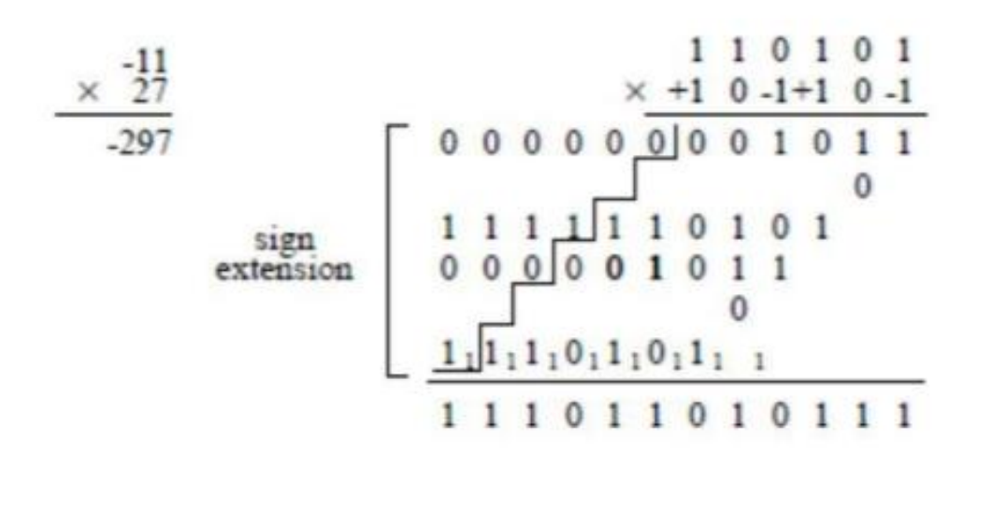
(c) A=110101 and B=011011
TU/e Processor Design 5Z032

Slide 49
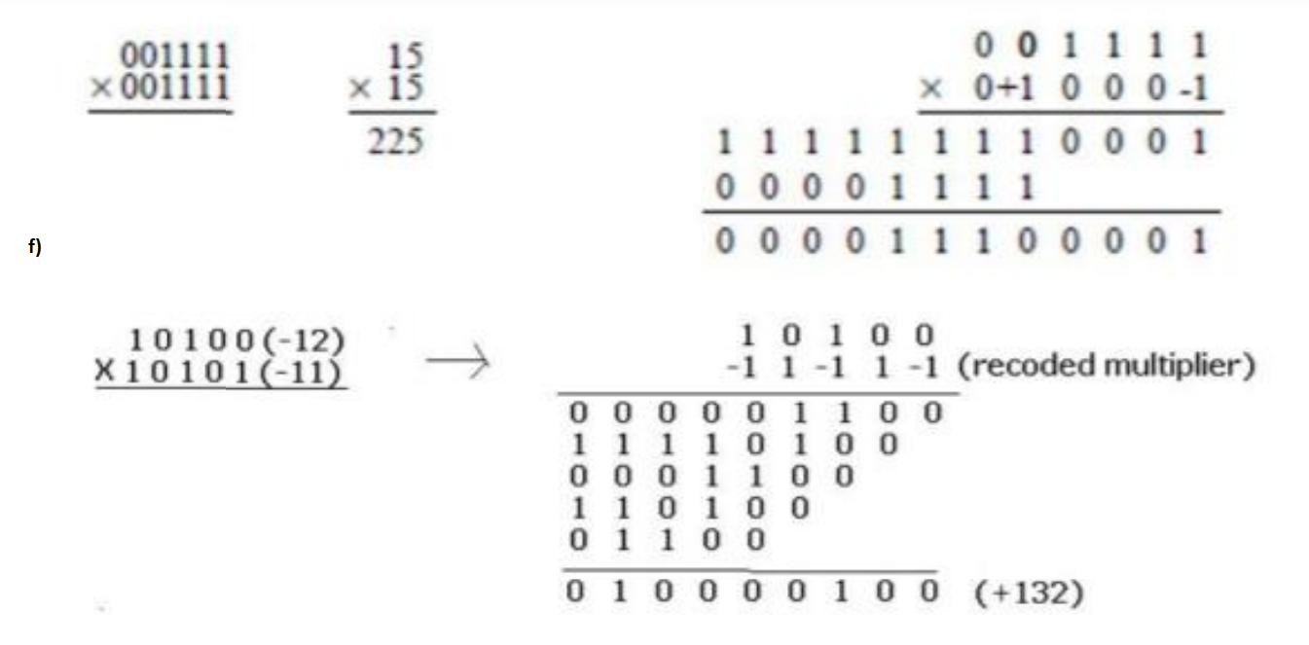
A=001111 and B=001111
(f) A=10100 and B=10101
(d) A=001111 and B=001111
TU/e Processor Design 5Z032

Slide 50
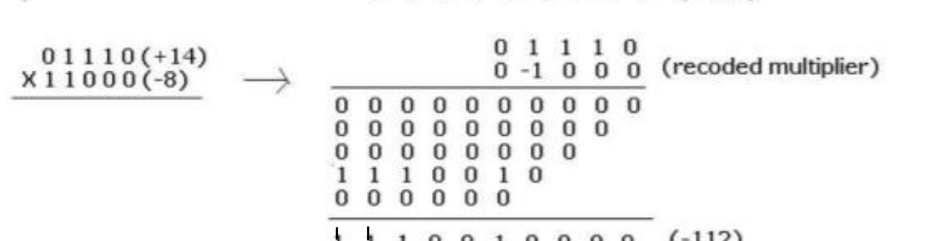
A=01110 and B=11000
TU/e Processor Design 5Z032

Slide 51
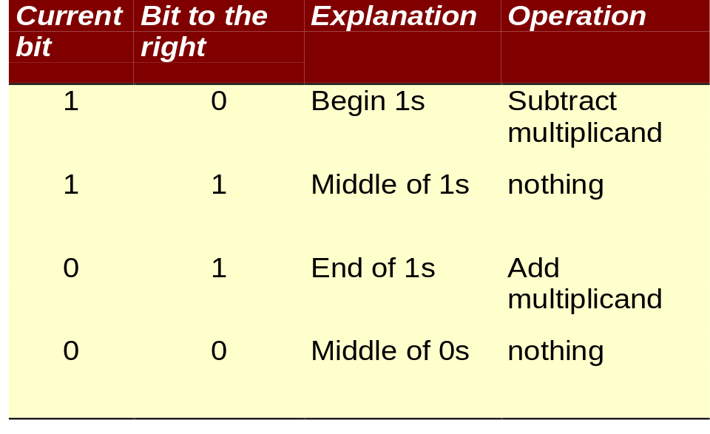
Fast multiply: Booth’s Algorithm
Exploit the fact that: 011111 = 100000 - 1
Therefore we can replace multiplier, e.g.:
0001111100 = 0010000000 - 100
Rules:
TU/e Processor Design 5Z032

Slide 52
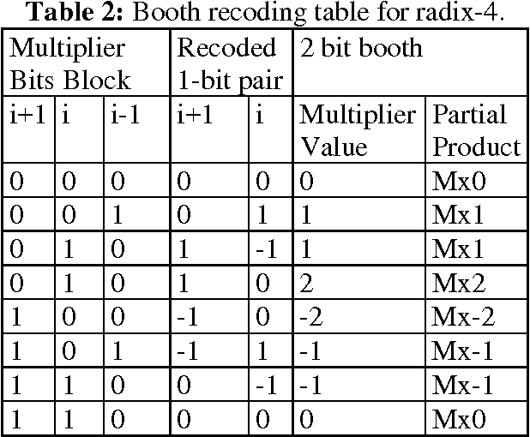
Modified Booth’s algorithm
TU/e Processor Design 5Z032

Slide 53
Divide (1)
Well known algorithm:
Dividend
Divisor 1000/1001010\1001 Quotient
-1000
10
101
1010
-1000
10 Remainder
TU/e Processor Design 5Z032

Slide 54
Division (2)
Start
1. Substract the Divisor register from the
Remainder register and place the
result in the Remainder register
Implementation:
Test Remainder
>= 0
< 0
2.a Shift the Quotient register
to the left, setting the
rightmost bit to 1
2.b Restore the original value by
adding the Divisor register. Also,
shift a 1 into the Quotient register
Divisor
Shift right
Shift Divisor Register right 1 bit
6
4
b
i
t
s
Quotient
33rd repetition?
no
6
4
-
b
i
t
A
L
U
Shift left
3
2
b
i
t
s
Remainder
yes
W
r
i
t
e
C
o
n
t
r
o
l
t
e
s
t
6
4
b
i
t
s
Done
TU/e Processor Design 5Z032

Slide 55
Non-Restoring Division Algorithm for Unsigned Integer
Instead of the quotient digit set {0, 1}, the set {-1, 1} is used by the non-restoring division. The non-restoring division algorithm is more complex as compared to the restoring division algorithm. But when we implement this algorithm in hardware, it has an advantage, i.e., it contains only one decision and addition/subtraction per quotient bit. After performing the subtraction operation, there will not be any restoring steps. Due to this, the numbers of operations basically cut down up to half. Because of the less operation, the execution of this algorithm will be fast. This algorithm basically performs simple operations such as addition, subtraction. In this method, we will use the sign bit of register A. 0 is the starting value/bit of register A.

Slide 56
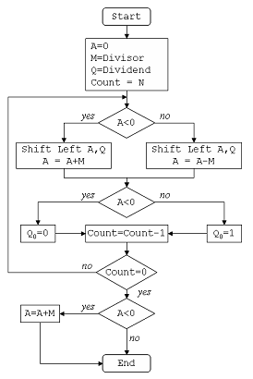
Non –Restoring Division algorithm
TU/e Processor Design 5Z032

Slide 57
Example non restoring division
Divide 11/3 using non restoring division algorithm
Dividend = 11
Divisor = 3
-M = 11101
TU/e Processor Design 5Z032

Slide 58
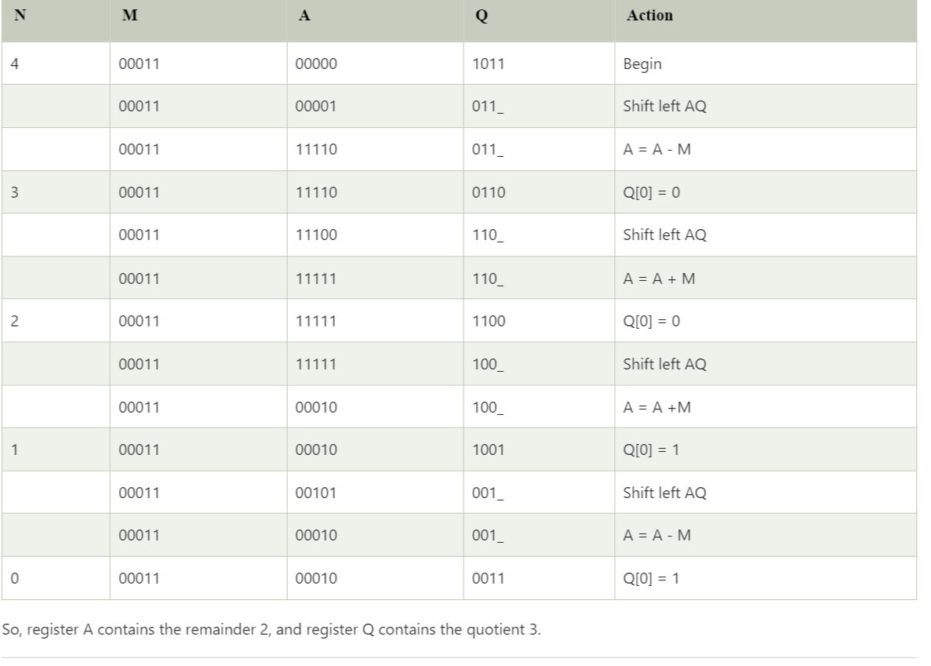
Non restoring division algorithm
TU/e Processor Design 5Z032

Slide 59
The Restoring Division Algorithm
The Restoring Division Algorithm is a method used to perform division operations on unsigned integers in computer arithmetic. It's designed to efficiently compute the quotient and remainder when dividing one unsigned integer (dividend) by another (divisor), while also minimizing the number of computational steps.
TU/e Processor Design 5Z032

Slide 60
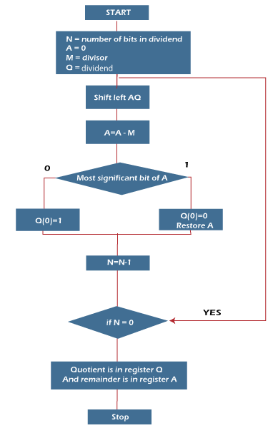
Restoring division algorithm
TU/e Processor Design 5Z032

Slide 61
Exercise
Divide using restoring division algorithm for the numbers 11 and 3, where 11 is the dividend and 3 is the divisor.
TU/e Processor Design 5Z032

Slide 62
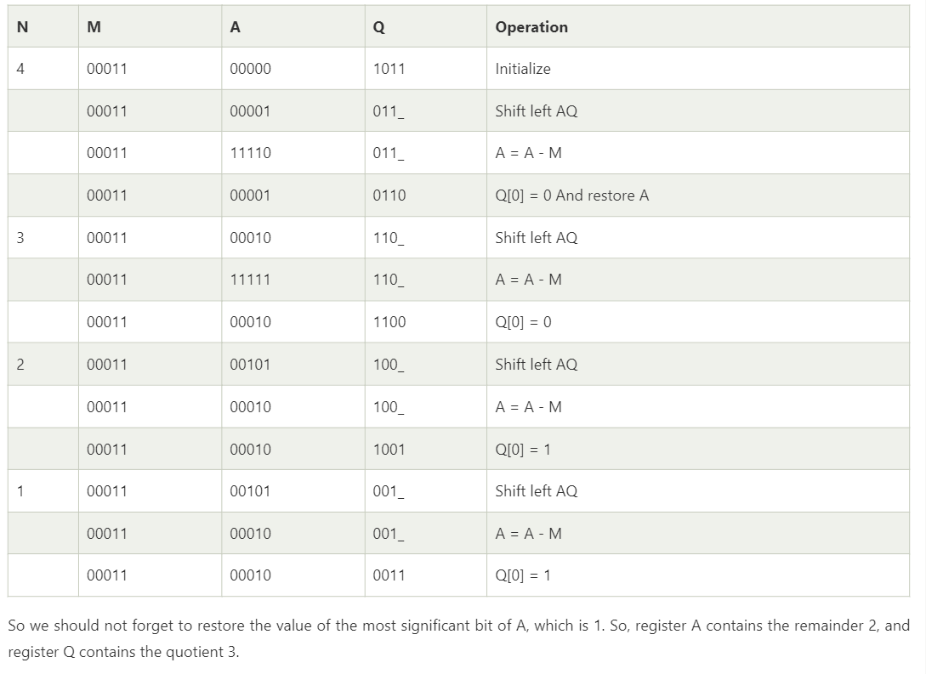
TU/e Processor Design 5Z032

Slide 63
Floating Point (a brief look)
We need a way to represent
  numbers with fractions, e.g., 3.1416
  very small numbers, e.g., .000000001
  very large numbers, e.g., 3.15576 × 10⁹
Representation:
  sign, exponent, significand: (–1)^{sign} × significand × 2^{exponent}
  more bits for significand gives more accuracy
  more bits for exponent increases range
IEEE 754 floating point standard:
  single precision : 8 bit exponent, 23 bit significand
  double precision: 11 bit exponent, 52 bit significand
TU/e Processor Design 5Z032

Slide 64
IEEE 754 floating-point standard
Leading “1” bit of significand is implicit
Exponent is “biased” to make sorting easier
  all 0s is smallest exponent all 1s is largest
  bias of 127 for single precision and 1023 for double precision
  summary: (–1)^{sign} × (1+significand) × 2^{exponent – bias}
Example:
  decimal: -.75 = -3/4 = -3/2²
  binary : -.11 = -1.1 x 2⁻¹
  floating point: exponent = -1+bias = 126 = 01111110
  IEEE single precision:
31 30 29 28 27 26 25 24 23 22 21 20 19 18 17 16 15 14 13 12 11 10 9 8 7 6 5 4 3 2 1 0
1 0 1 1 1 1 1 1 0 1 0 0 0 0 0 0 0 0 0 0 0 0 0 0 0 0 0 0 0 0 0 0
TU/e Processor Design 5Z032

Slide 65
Floating Point Complexities
Operations more complicated: align, renormalize, ...
In addition to overflow we can have “underflow”
Accuracy can be a big problem
  IEEE 754 keeps two extra bits, guard and round, and additional sticky bit (indicating if one of the remaining bits unequal zero)
  four rounding modes
  positive divided by zero yields “infinity”
  zero divide by zero yields “not a number”
  other complexities
Implementing the standard can be tricky
Not using the standard can be even worse
  see text for description of 80x86 and Pentium bug!
TU/e Processor Design 5Z032

Slide 66
Floating Point on MIPS
Separate register file for floats: 32 single precision registers; can be used as 16 doubles
MIPS-1 floating point instruction set (pg 288/291)
  addition add.f (f =s (single) or f=d (double))
  subtraction sub.f
  multiplication mul.f
  division div.f
  comparison c.x.f where x=eq, neq, lt, le, gt or ge
    sets a bit in (implicit) condition reg. to true or false
  branch bc1t (branch if true) and bclf (branch if false)
    c1 means instruction from coprocessor one !
  load and store: lwc1, swc1
Study examples on page 293, and 294-296
TU/e Processor Design 5Z032

Slide 67
Floating Point on MIPS
MIPS has 32 single-precision FP registers ($f0,$f1, …,$f31) or 16 double-precision ($f0,$f2,...)
MIPS FP instructions:
FP add single add.s $f0,$f1,$f2 $f0 = $f1+$f2
FP substract single sub.s $f0,$f1,$f2 $f0 = $f1-$f2
FP multiply single mul.s $f0,$f1,$f2 $f0 = $f1x$f2
FP divide single div.s $f0,$f1,$f2 $f0 = $f1/$f2
FP add double add.d $f0,$f2,$f4 $f0 = $f2+$f4
FP substract double sub.d $f0,$f2,$f4 $f0 = $f2-$f4
FP multiply double mul.d $f0,$f2,$f4 $f0 = $f2x$f4
FP divide double div.d $f0,$f2,$f4 $f0 = $f2/$f4
load word coprocessor 1 lwc1 $f0,100($s1) $f0 = Memory[$s1+100]
store word coprocessor 1 swc1 $f0,100($s1) Memory[$s1+100] = $f0
branch on copr.1 true bc1t 25 if (cond) goto PC+4+100
branch on copr.1 false bc1f 25 if (!cond) goto PC+4+100
FP compare single c.lt.s $f0,$f1 cond = ($f0 < $f1)
FP compare double c.ge.d $f0,$f2 cond = ($f0 >= $f2)
TU/e Processor Design 5Z032

Slide 68
Conversion: decimal ➔ IEEE 754 FP
Decimal number (base 10)
    123.456 = 1x10²+2x10¹+3x10⁰+4x10⁻¹+5x10⁻²+6x10⁻³
Binary number (base 2)
    101.011 = 1x2²+0x2¹+1x2⁰+0x2⁻¹+1x2⁻²+1x2⁻³
Example conversion: 5.375
  Multiply with power of 2, to get rid of fraction:
    5.375 = 5.375x16 / 16 = 86 x 2⁻⁴
  Convert to binary, and normalize to 1.xxxxx
    86 x 2⁻⁴ = 1010110 x 2⁻⁴ = 1.01011 x 2²
  Add bias (127 for single precision) to exponent:
    exponent field = 2 + 127 = 129 = 1000 0001
  IEEE single precision format (remind the leading “1” bit):
0 10000001 01011000000000000000000
sign exponent significand
TU/e Processor Design 5Z032

Slide 69
Summary
Computer arithmetic is constrained by limited precision
Bit patterns have no inherent meaning but standards do exist
  two’s complement
  IEEE 754 floating point
Computer instructions determine “meaning” of the bit patterns
Performance and accuracy are important so there are many complexities in real machines (i.e., algorithms and implementation).
We are ready to move on (and implement the processor)
you may want to look back (Section 4.12 is great reading!)
TU/e Processor Design 5Z032

